Slide 1


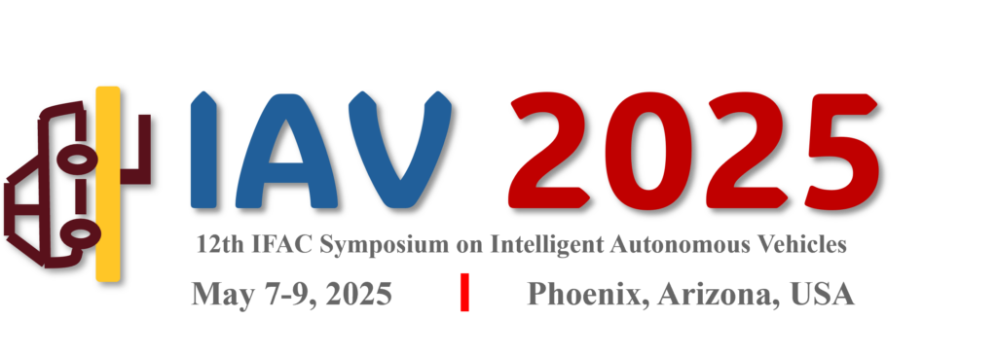
A Distributionally Robust
Input & State Estimation Approach
Towards Resilient Tracking in Autonomous Vehicles
Kasra Azizi, Kumar Anurag, Wenbin Wan
University of New Mexico
May 07, 2025
📍 Phoenix, Arizona, USA

Slide 2
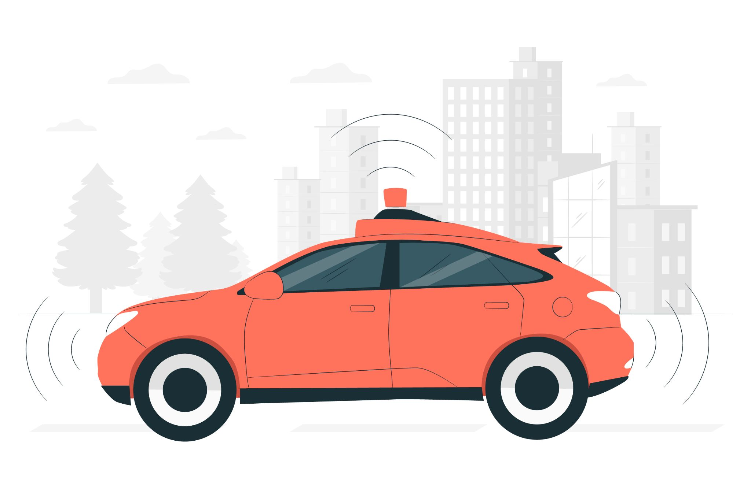
Introduction - Problem & Solution
The Problem
Safety
State Data
Noisy Measurements
The Solution
Fuse Data
Estimate State Using Model
Ensure Reliability
Image Source: Freepik
K. Azizi, K. Anurag, W. Wan | University of New Mexico

Slide 3
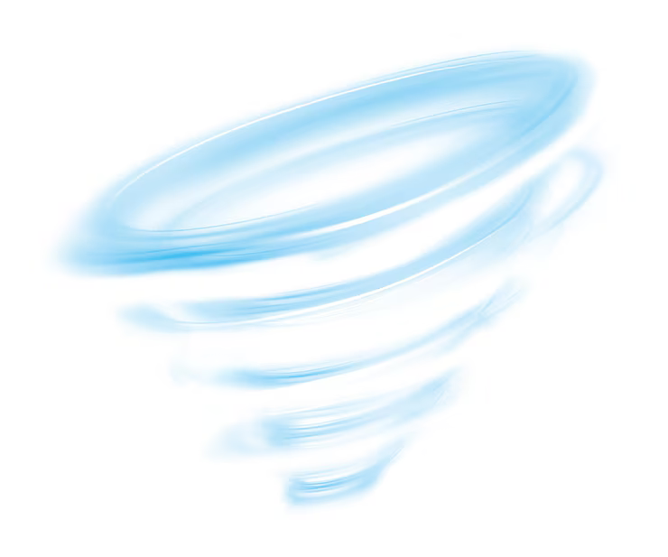
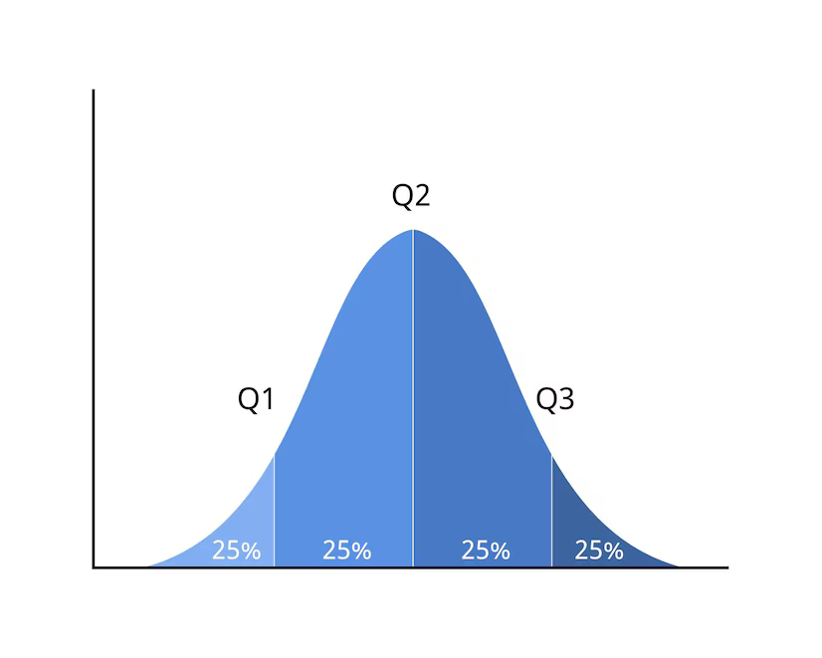
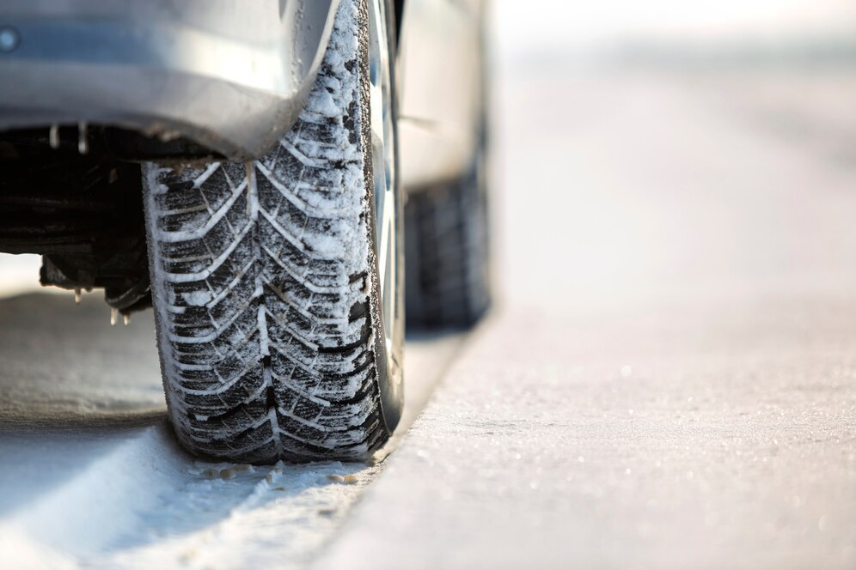
Baseline - Input & State Estimation (ISE)
Core Idea
Joint Estimation
State & Unknown Input
Enhance Prediction
Key Limitation
Sensitive to:
Non-Linearity
Non-Gaussian Noise
Outliers
Image Source: Freepik
K. Azizi, K. Anurag, W. Wan | University of New Mexico

Slide 4
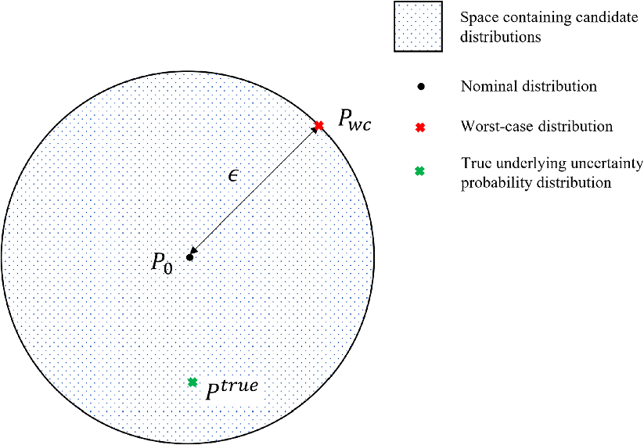
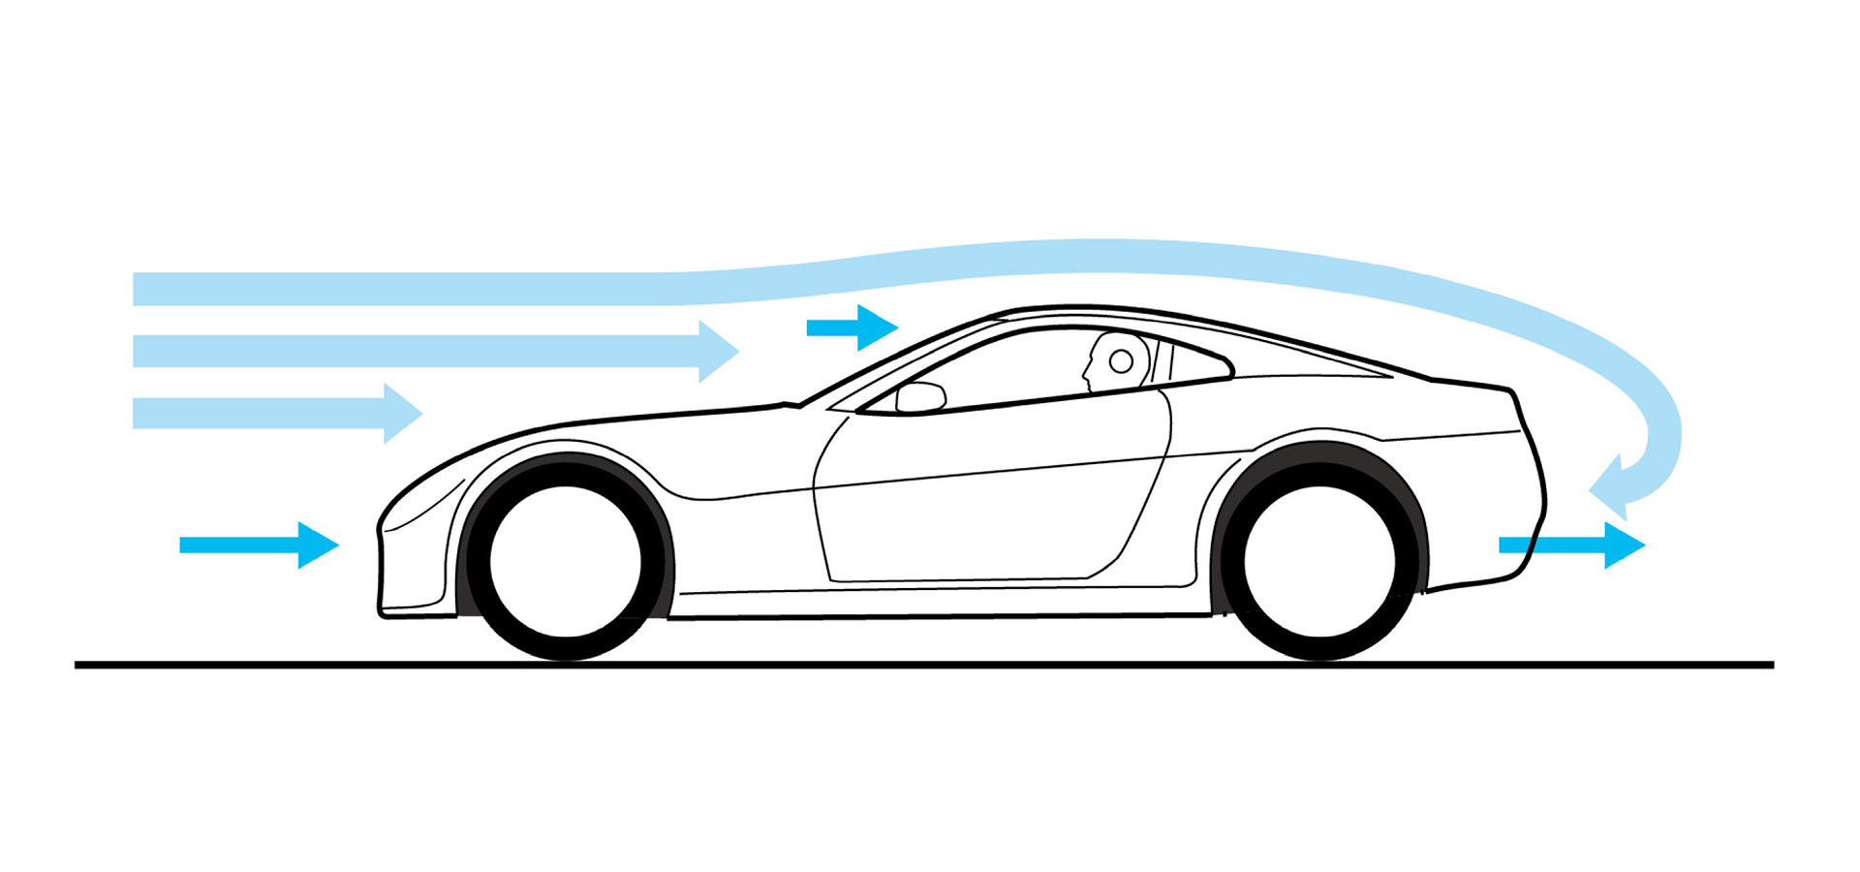
Baseline - Distributionally Robust Estimation (DRE)
Core Idea
Robustness
Deviating Noise Distributions
Ambiguity Sets
Worst-Case Optimization
Key Limitation
Sensitive to Outliers
Ignores Unknown Inputs
Image Source: Researchgate.net, Gran-Turismo
K. Azizi, K. Anurag, W. Wan | University of New Mexico

Slide 5
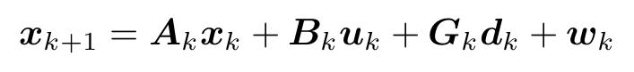
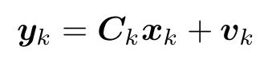
Problem Formulation
System Model
unknown input
state vector
known input
uncertain process
noise distribution
sensor measurements containing outliers
uncertain measurement
noise distribution
K. Azizi, K. Anurag, W. Wan | University of New Mexico

Slide 6
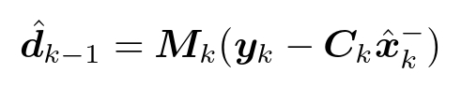
Building Block 1: Unknown Input Estimation
Unknown Forces
actual measurement
unknown input
expected value
gain matrix
Image Source: Freepik
K. Azizi, K. Anurag, W. Wan | University of New Mexico

Slide 7
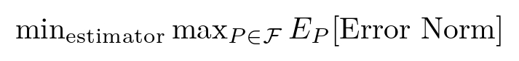
Building Block 2: Distributionally Robust Estimation
Unknown Noises
worst-case scenario
best performance estimator
ambiguity set
Image Source: Researchgate.net
K. Azizi, K. Anurag, W. Wan | University of New Mexico

Slide 8
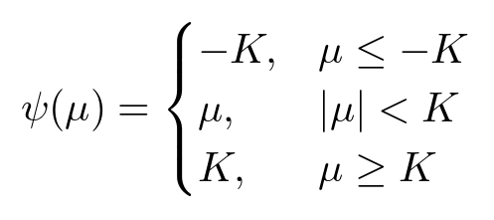
Building Block 3: Robust Update
Outliers
measurement residual
tuning threshold
K. Azizi, K. Anurag, W. Wan | University of New Mexico

Slide 9
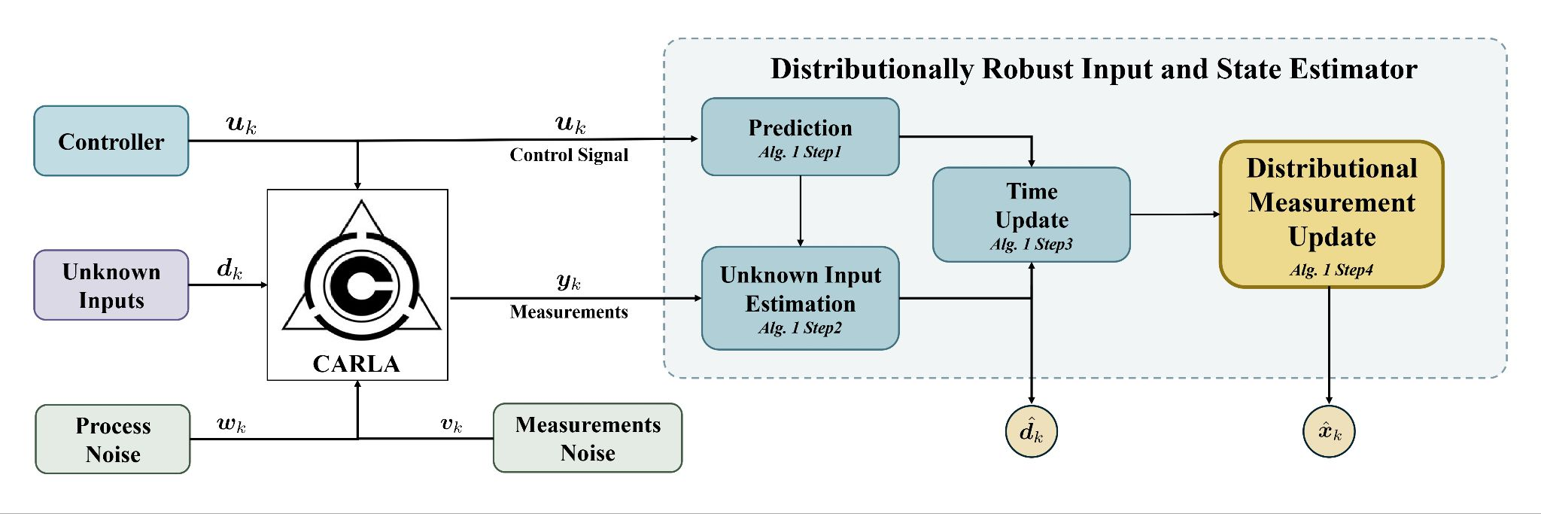
Block Diagram - DRISE Framework
K. Azizi, K. Anurag, W. Wan | University of New Mexico

Slide 10
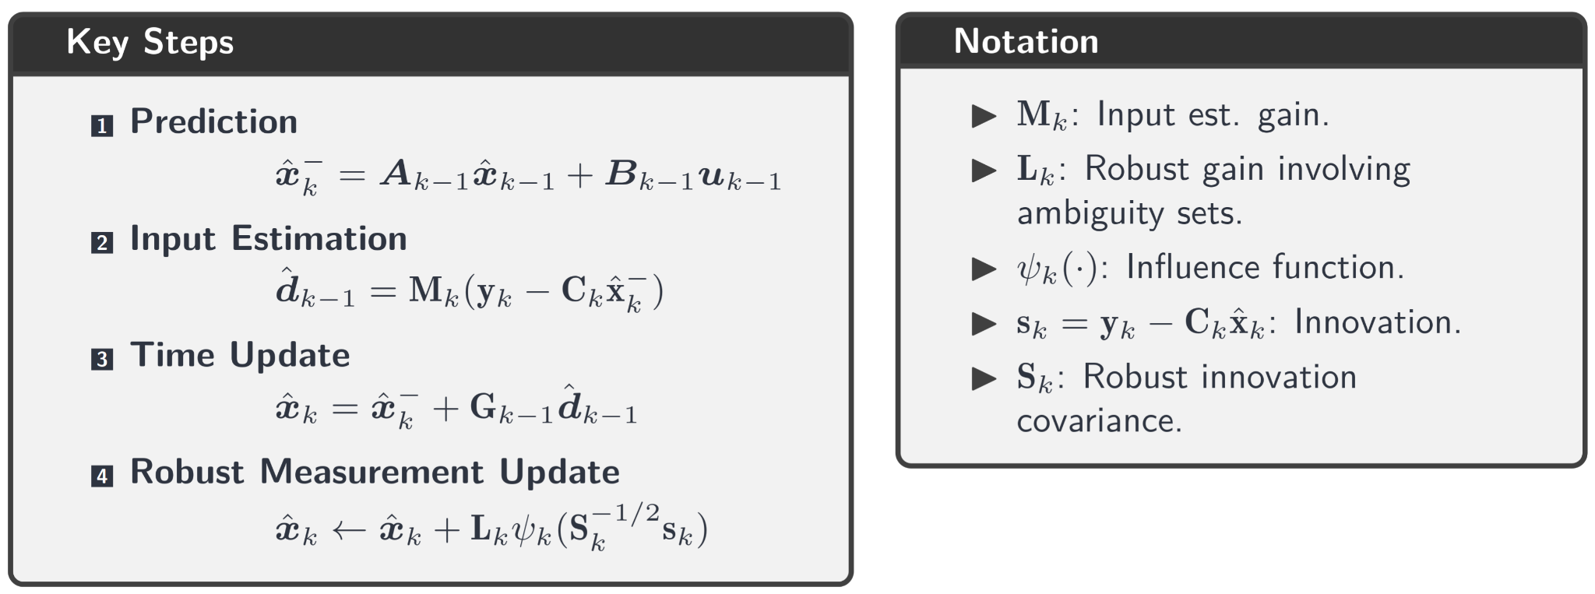
The DRISE Algorithm Cycle
K. Azizi, K. Anurag, W. Wan | University of New Mexico

Slide 11
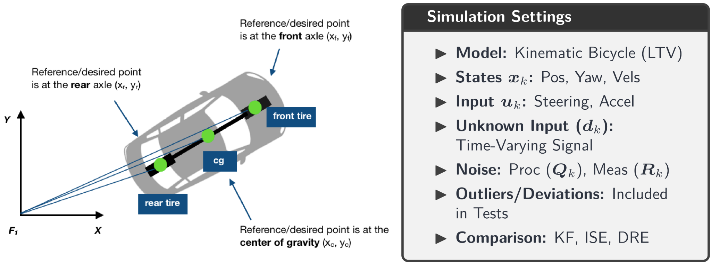
Simulation Setup
K. Azizi, K. Anurag, W. Wan | University of New Mexico

Slide 12
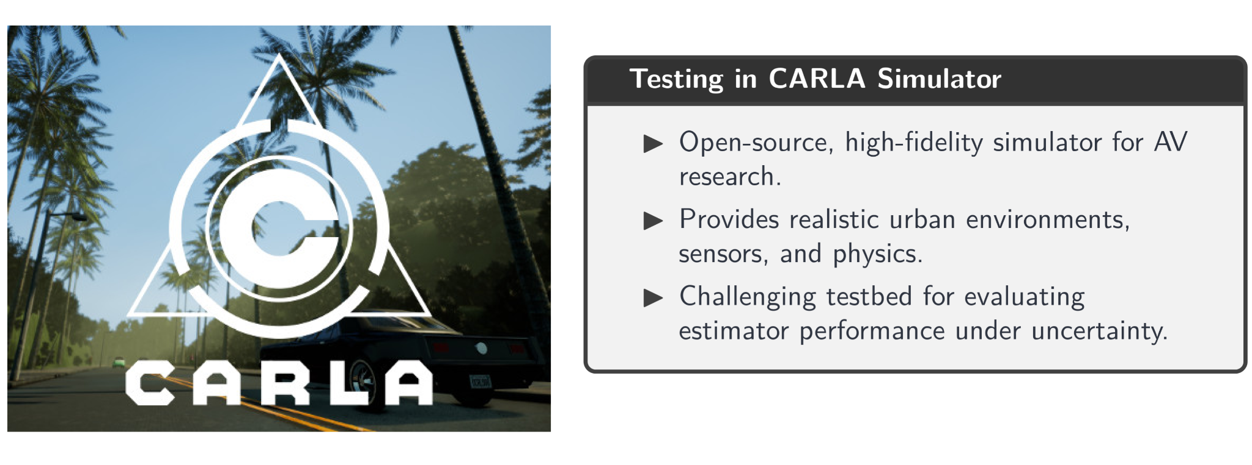
CARLA Simulation Environment
K. Azizi, K. Anurag, W. Wan | University of New Mexico

Slide 13
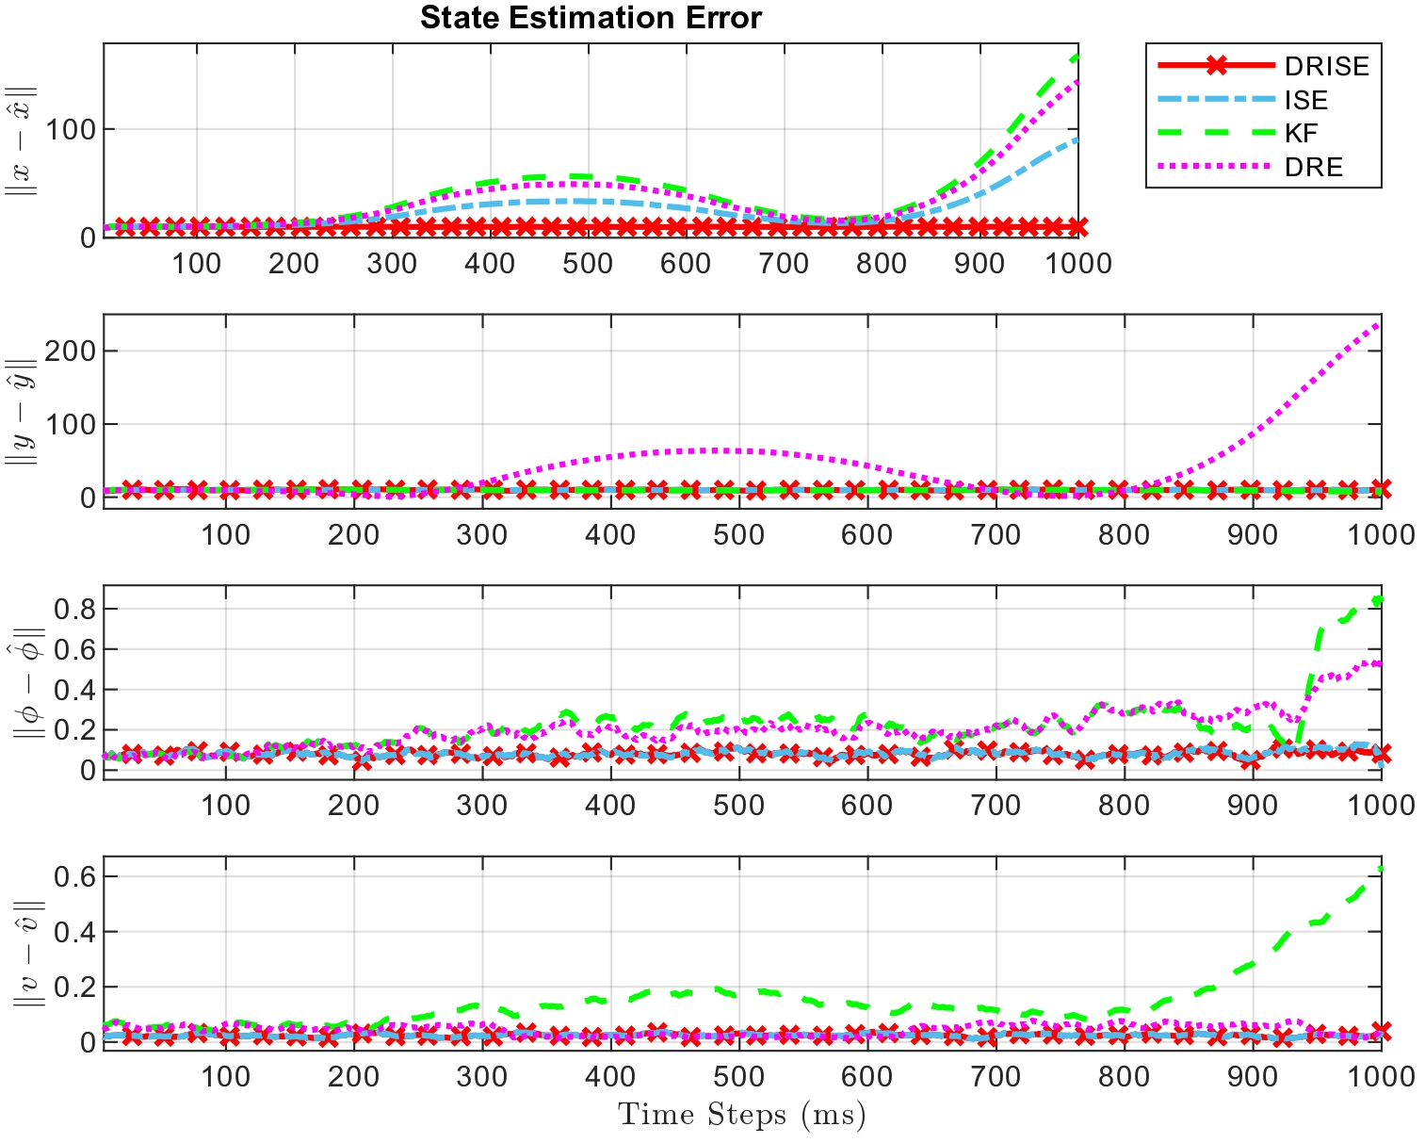
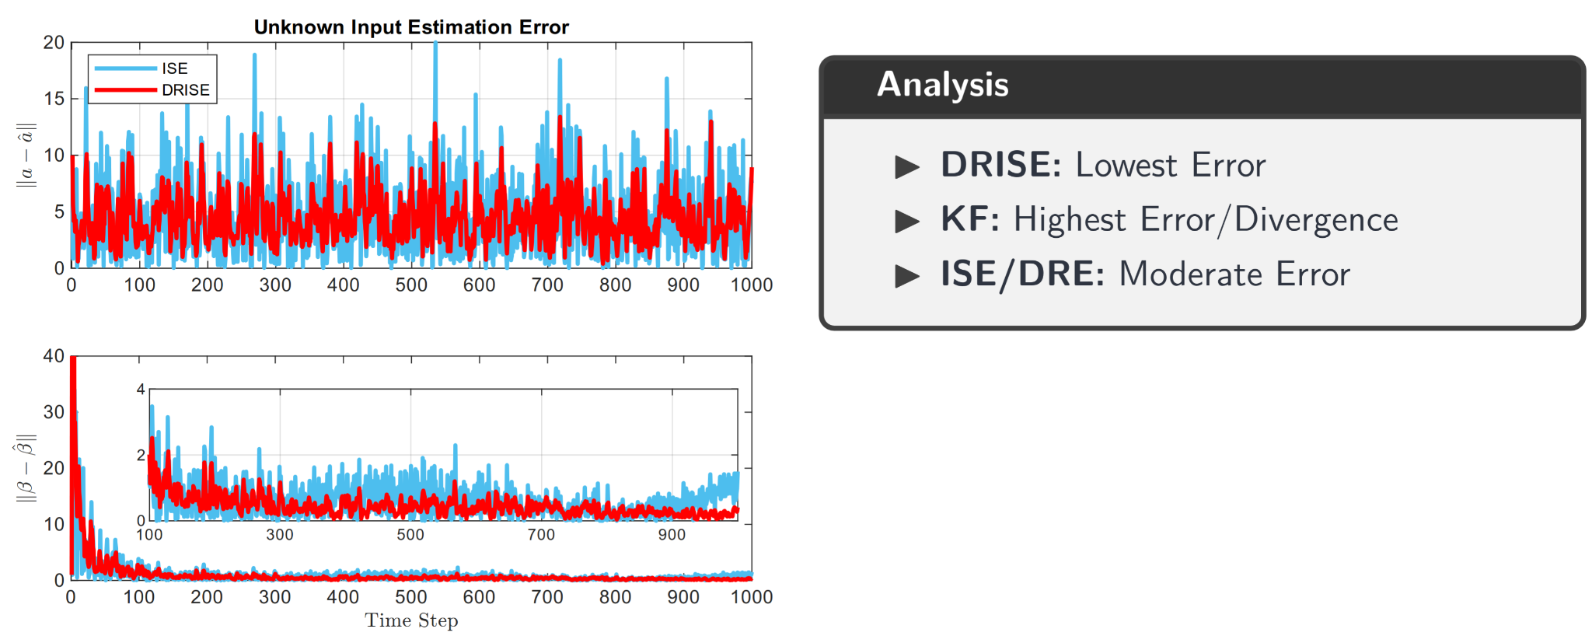
Results: State Estimation Error
K. Azizi, K. Anurag, W. Wan | University of New Mexico

Slide 14
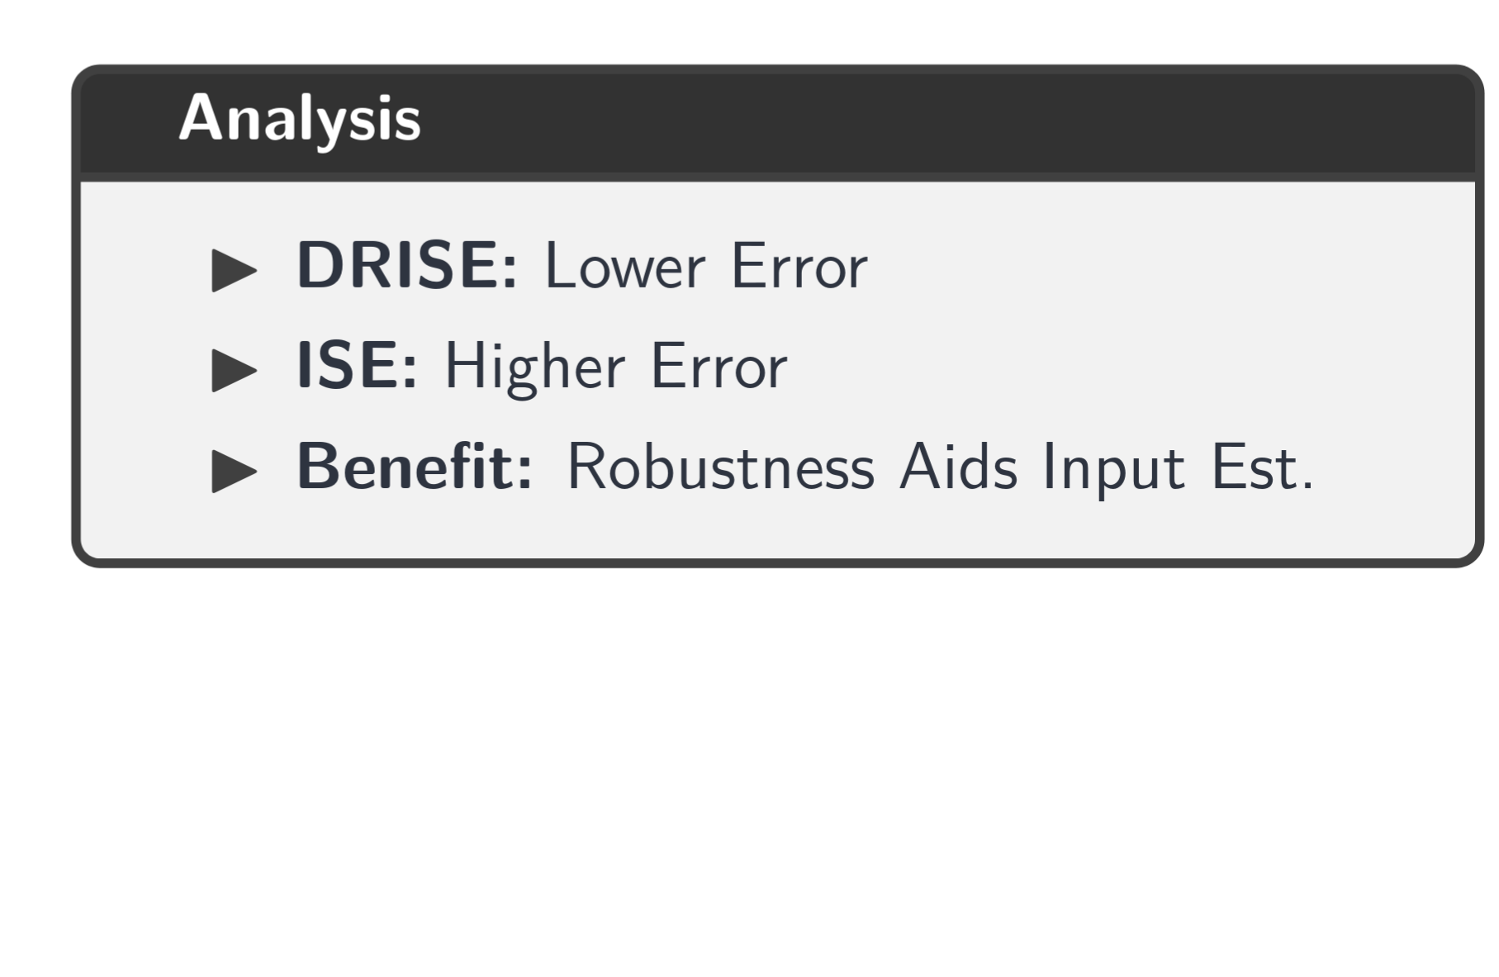
Results: Unknown Input Error
K. Azizi, K. Anurag, W. Wan | University of New Mexico

Slide 15
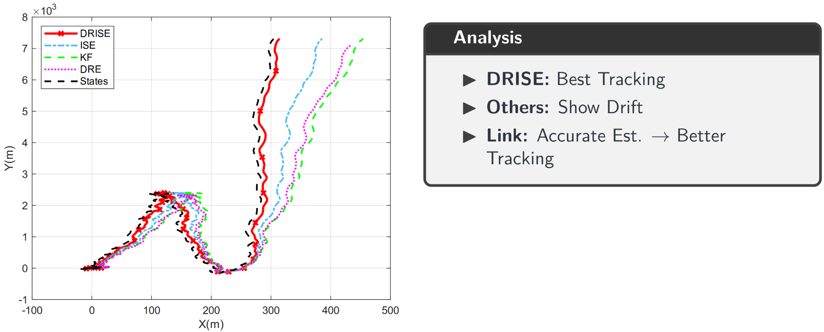
Results: Trajectory Tracking
K. Azizi, K. Anurag, W. Wan | University of New Mexico

Slide 16
Future Work
Kullback-Leibler divergence
Wasserstein distance
K. Azizi, K. Anurag, W. Wan | University of New Mexico

Slide 17
Thank you!
Questions?
😊

